Slide 1
English Grammar
Parts
of
Speech

Slide 2
Eight Parts of Speech
Nouns
Verbs
Interjections
Pronouns
Adjectives
Adverbs
Prepositions
Conjunctions

Slide 3



Word that names
Noun:
A Person
A Place
A Thing
An Idea

Slide 4
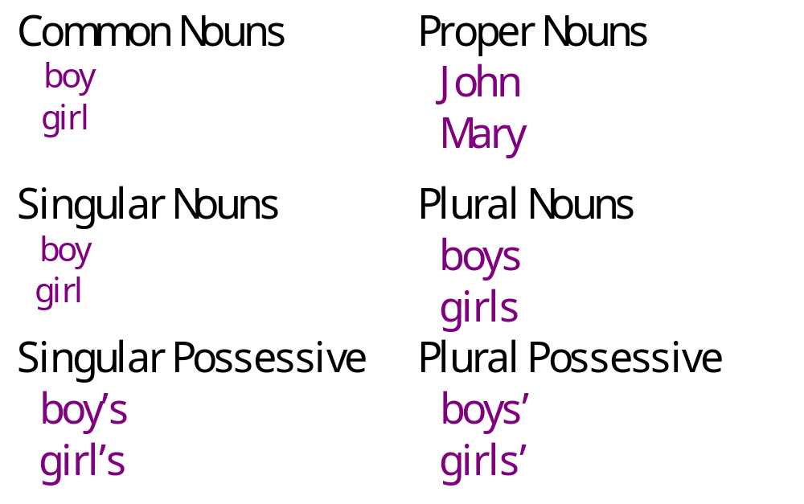

Kinds of Nouns

Slide 5
Kinds of Nouns
Abstract Nouns like Happiness, Youth, Beauty, Pride, Height etc.
Collective Nouns like Group, Class, Bouquet, Flock, Bunch, Herd, Pride etc.

Slide 6
The Verb
A word that expresses action or otherwise helps to make a statement
“be” verbs
&
taste
feel
sound
look
appear
become
seem
grow
remain
stay
Action
Subject
Linking
predicate

Slide 7
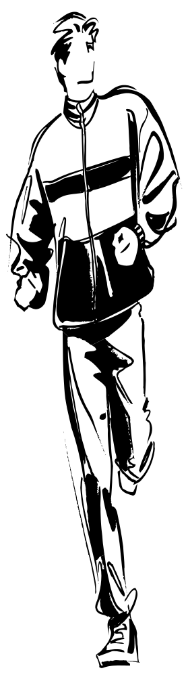
Every sentence must have
VERB
a

Slide 8
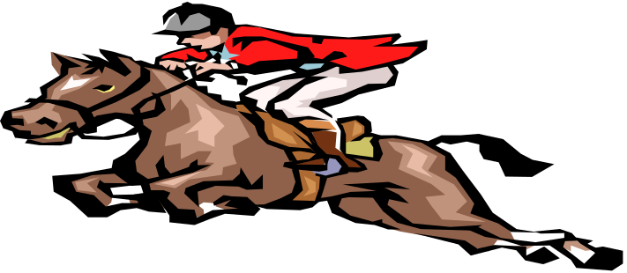

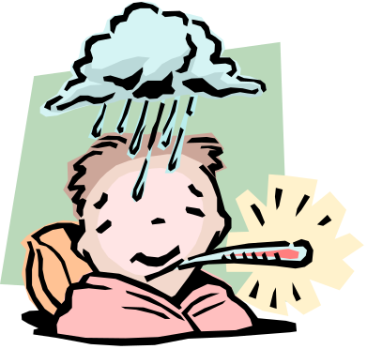
Kinds of Verbs
Action verbs express mental or physical action.
Linking verbs make a statement by connecting the subject with a word that describes or explains it.
He rode the horse to victory.
He has been sick.

Slide 9
The Pronoun
The pronoun is a word used in place of one or more nouns.
It may stand for a person, place, thing, or idea.
Personal Pronouns
I, me, mine
you, your, yours
she, her, hers,
it, its
we,us, our, ours
they, them, their,
theirs
myself
yourself
Indefinite Pronouns
anybody
each
either
none
someone, one, etc.
Demonstrative Pronouns
this
that
these
those
Interrogative Pronouns
who
whom
what
which
whose

Slide 10

The Adjective
Modifies or describes a
noun or pronoun.
Answers these questions:
Did you lose your address
book?
Which?
Is that a wool sweater?
What kind?
Just give me five minutes.
How many?

Slide 11
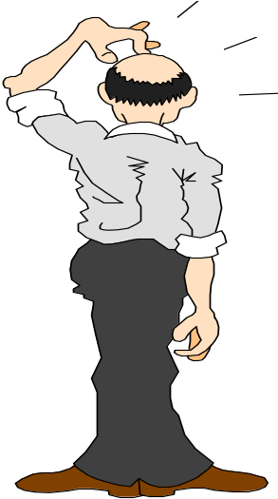
The Adverb
Modifies or describes
a verb, an adjective,
or another adverb.
Answers the questions:
How?
He ran quickly.
When?
She left yesterday.
We went there.
Where?
It was too hot!
To what degree or how much?

Slide 12
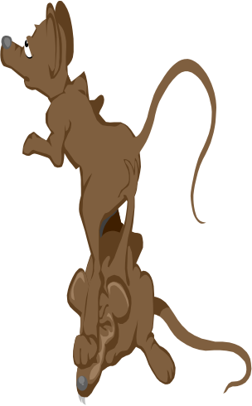
Kinds of Adverbs
Interrogative
Adverbs
introduce questions
How did you break your leg?
How?
When?
When does your plane leave?
How often do you run?
How often?
Where?
Where did you put the mouse trap?

Slide 13
The Preposition
A preposition introduces a noun or pronoun
or a phrase or clause functioning in the sentence
as a noun. The word or word group that the
preposition introduces is its object.
They received a postcard from Bobby telling
about his trip to Canada.

Slide 14

The preposition never stands alone!
noun
object of
preposition
preposition
pronoun
object
You can press those leaves under glass.
preposition
can have more than
one object
Her telegram to Nina and Ralph brought good news.
object can have modifiers
It happened during the last examination.

Slide 15
Some Common Prepositions
aboard
about
above
across
after
against
along
among
around
at
before
behind
below
beneath
beside
between
beyond
by
down
during
except
for
from
in
into
like
of
off
on
over
past
since
through
throughout
to
toward
under
underneath
until
up
upon
with
within
without

Slide 16
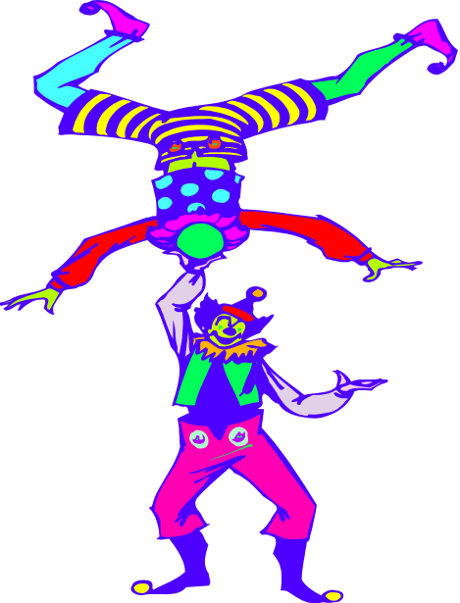
The Conjunction
A conjunction is a word that joins words
or groups of words.
or
and
neither/nor
either/or
but

Slide 17
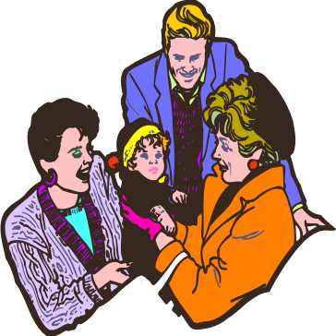
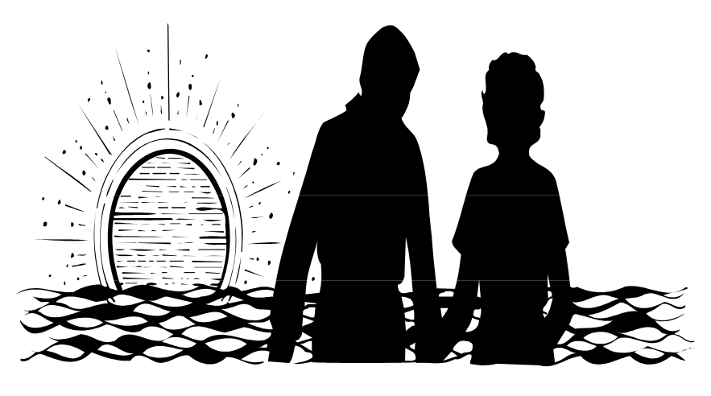

The Interjection
is an exclamatory word that expresses
emotion
Goodness! What a cute baby!
Wow! Look at that
sunset!

Slide 18
That’s all for now. . .
More Later

